Slide 1
ECBC & JSALC
2024년 9월 25일
Su-Hak Lee, Hee-Ju Yeo
Department of Computer Engineering

Slide 2
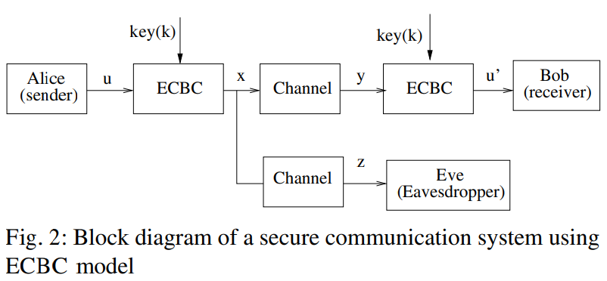
ECBC (Error Correction Based Cipher)

Slide 3
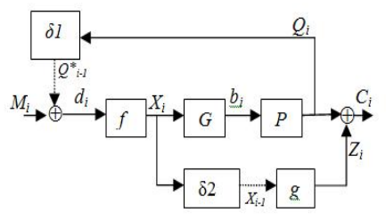
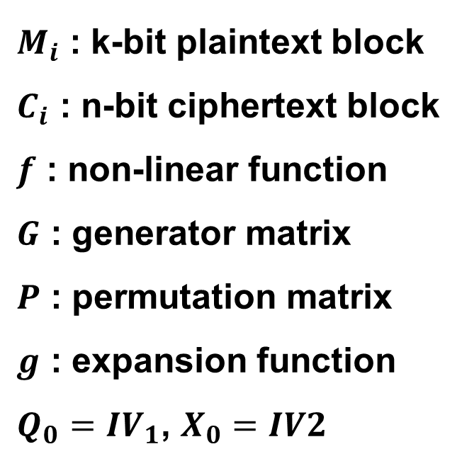
ECBC (Error Correction Based Cipher)
$M_{i}$ : k-bit plaintext block
$C_{i}$ : n-bit ciphertext block
$f$ : non-linear function
$G$ : generator matrix
$P$ : permutation matrix
$g$ : expansion function
$Q_{0}={IV}_{1}$, $X_{0}=IV2$

Slide 4
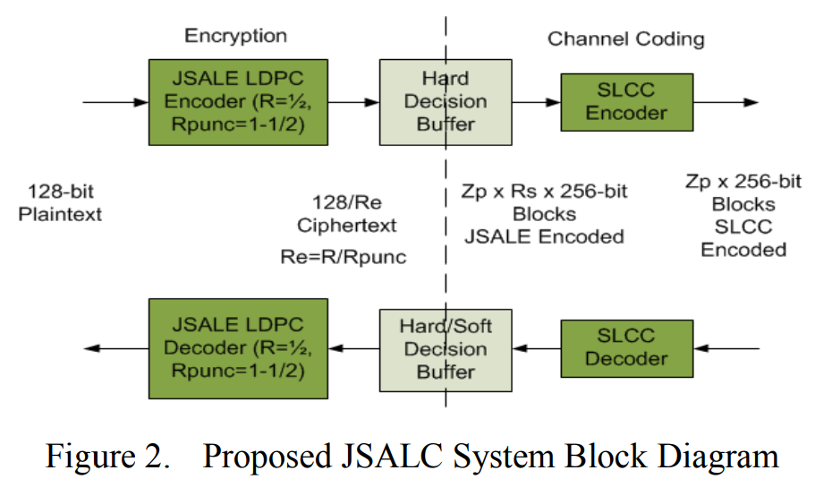
JSALC (Joint Security and Advanced Low Density Parity Check Coding)

Slide 5
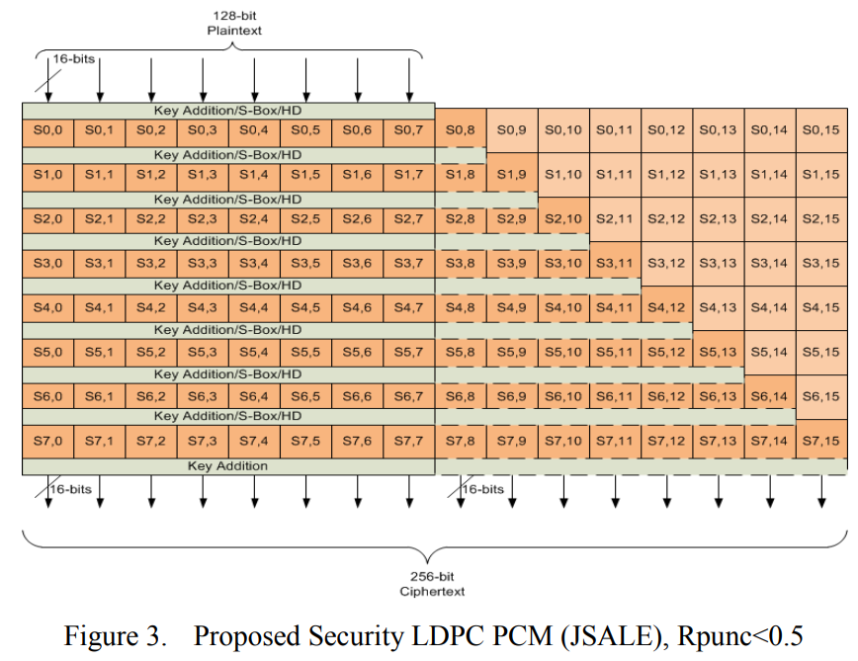
JSALE (Joint Security and Advanced LDPC Encryption)

Slide 6
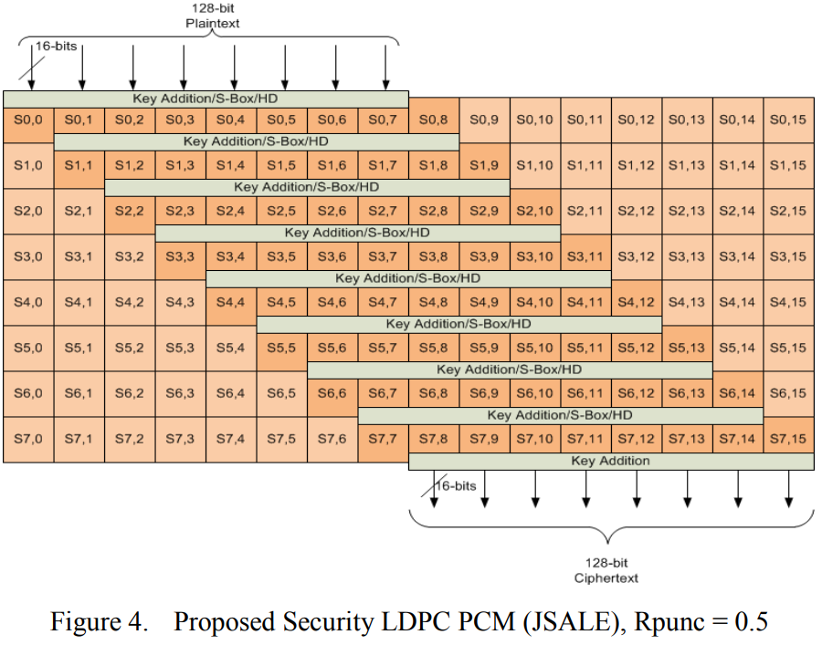
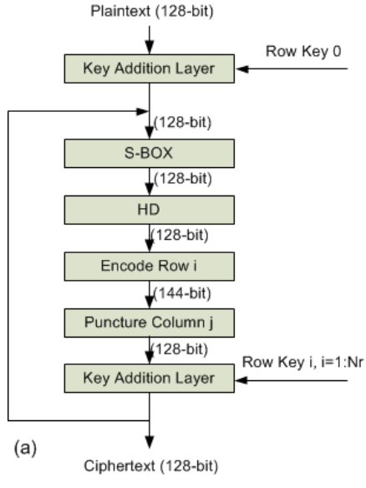
JSALE (Joint Security and Advanced LDPC Encryption)

